Slide 1
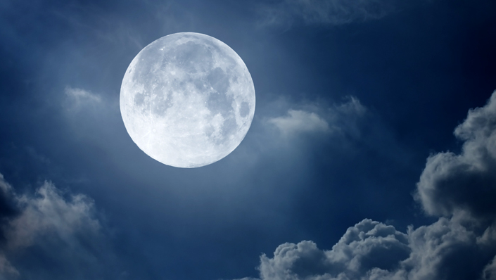
The Moon
[pail and pole]
In the heavens hover
the man and maid
Sægr and Simul
bearing from Byrgir
|
|
|
|
Hjúki and Bil:
in the moon are they.
the siblings hold,
the blessed water.
— Upphaf, ‘’The Beginning”

Slide 2
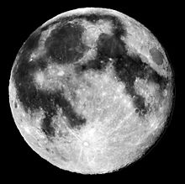
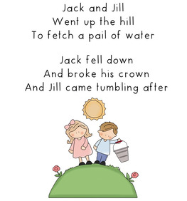
Hjúki & Bil Jack & Jill

Slide 3
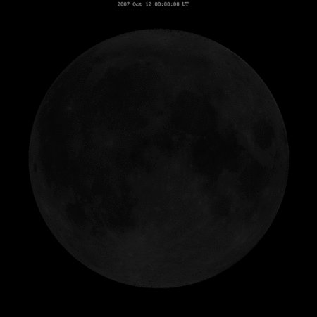
Hjúki & Bil Jack & Jill

Slide 4
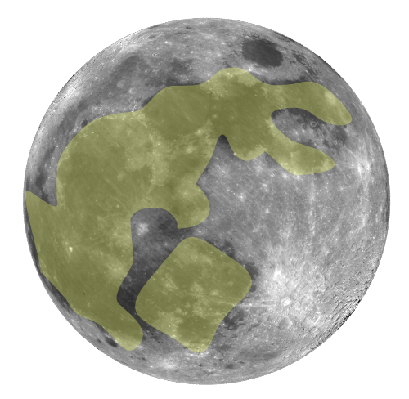
Moon Rabbit
Asian Folklore
Rice Cake / Elixir of Life
Starving man and the rabbit
Native American Folklore
Starving man and the rabbit
Nanahuatzin and Tecciztecatl
Crane and the Rabbit

Slide 5
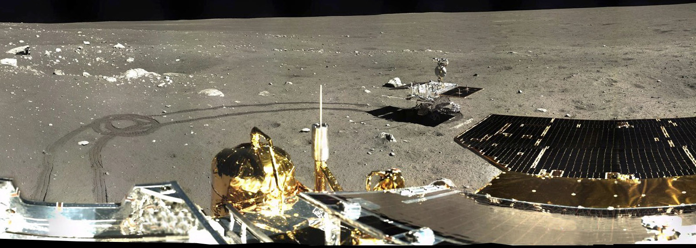
Lander
Cháng'é sān hào
(Chang’e 3)
Rover
Yùtù
(Jade Rabbit)

Slide 6
Apollo 11
Houston: Among the large headlines concerning Apollo this morning, is one asking that you watch for a lovely girl with a big rabbit. An ancient legend says a beautiful Chinese girl called Chang-O has been living there for 4,000 years. It seems she was banished to the Moon because she stole the pill of immortality from her husband. You might also look for her companion, a large Chinese rabbit, who is easy to spot since he is always standing on his hind feet in the shade of a cinnamon tree. The name of the rabbit is not reported.
Michael Collins: Okay. We'll keep a close eye out for the bunny girl.

Slide 7
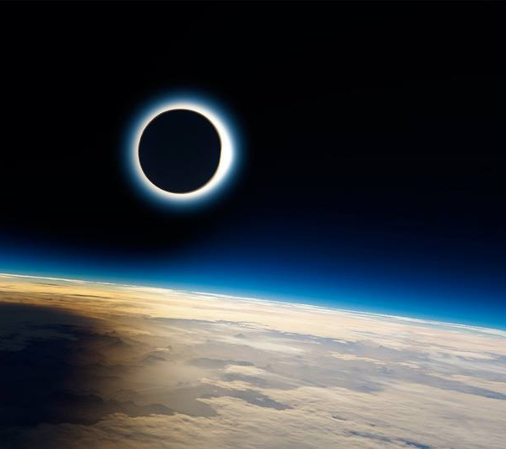
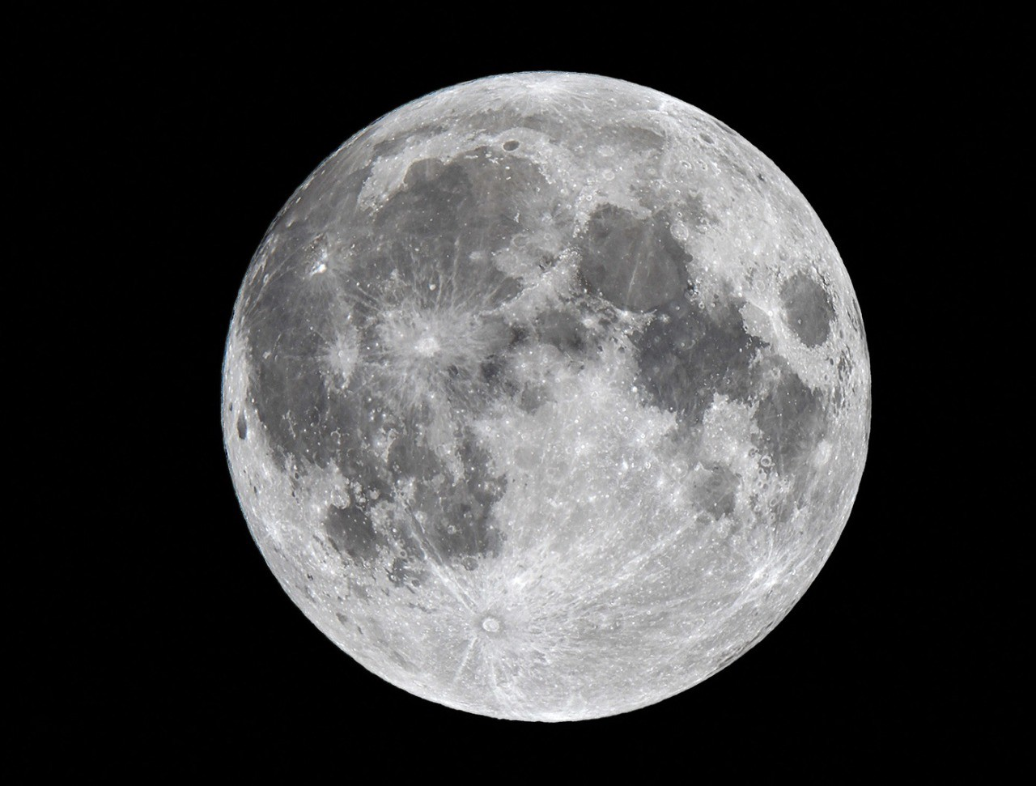
New and Full Moons

Slide 8
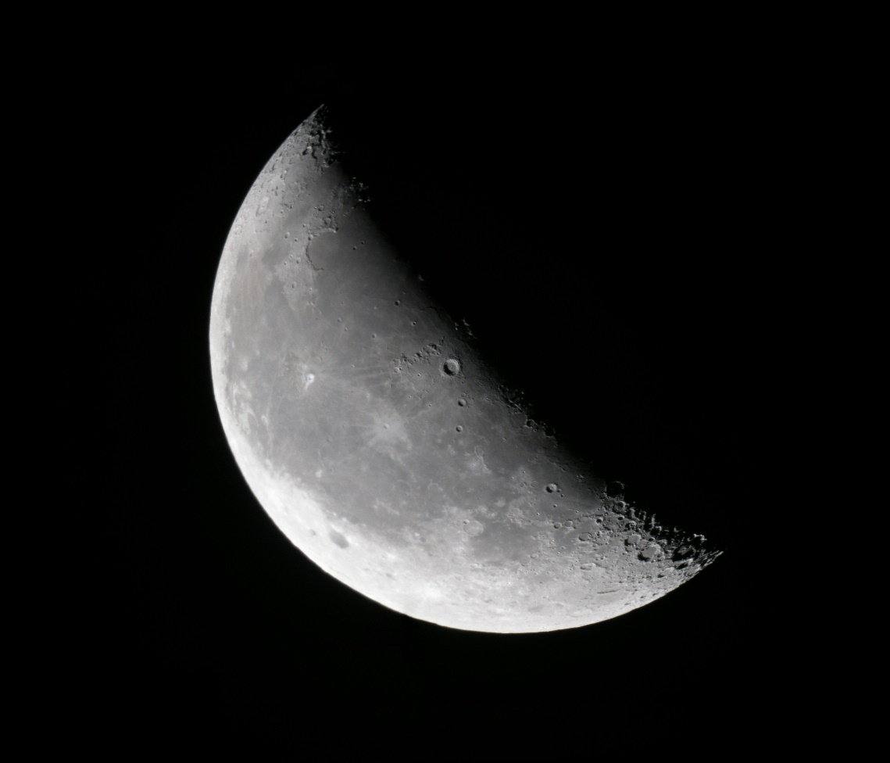
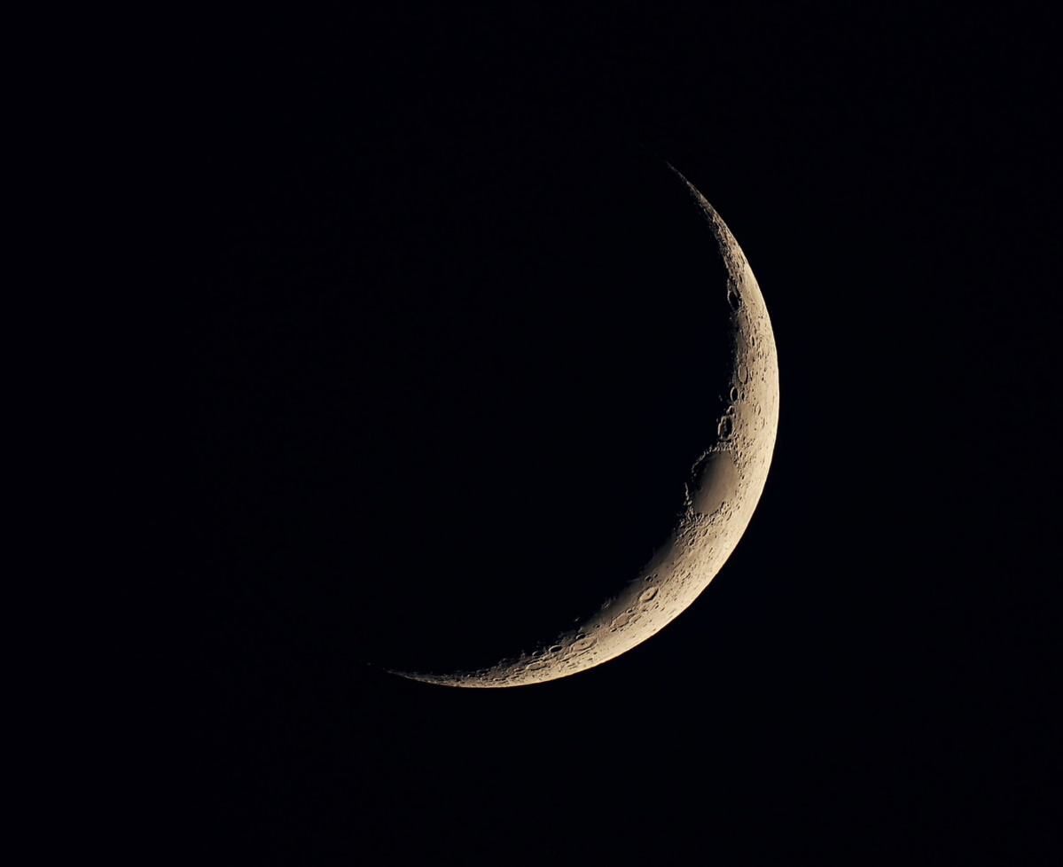
Crescent Moon

Slide 9
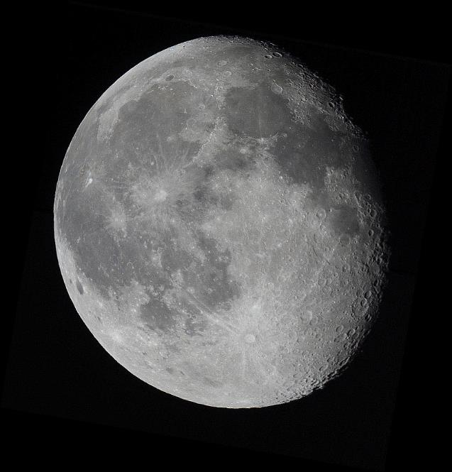
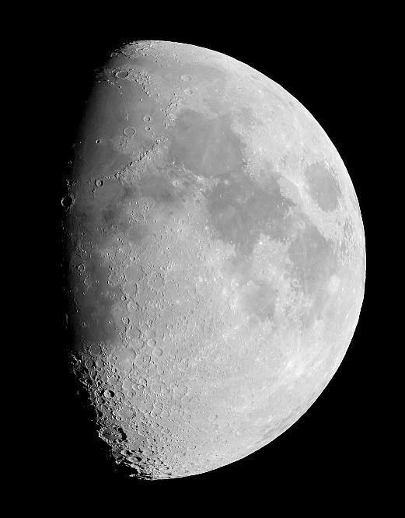
Gibbous Moon

Slide 10
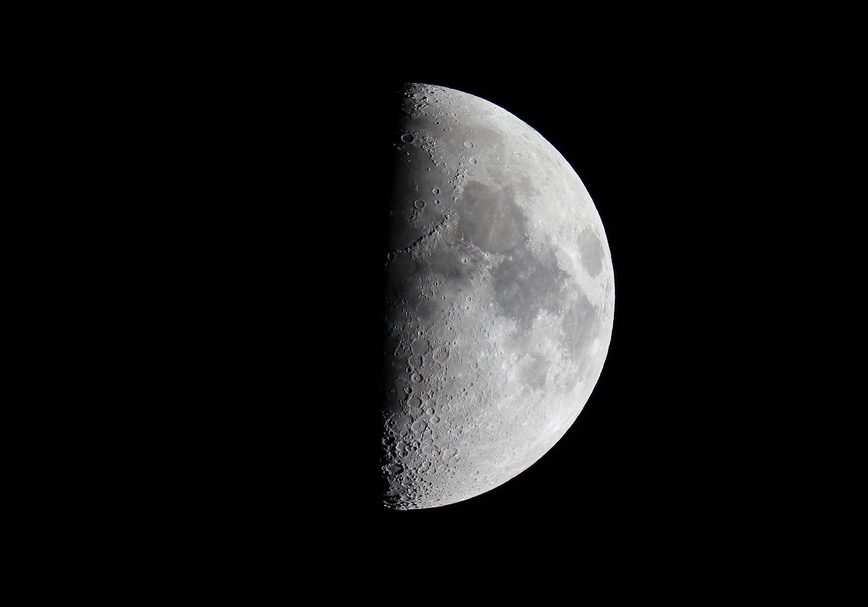
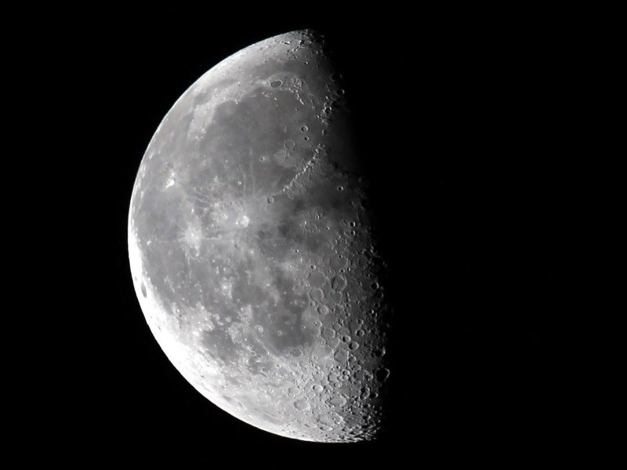
First and Last Quarter

Slide 11
Waxing & Waning
Waxing Phase
Waning Phase
Right side is illuminated
Left side is illuminated

Slide 12
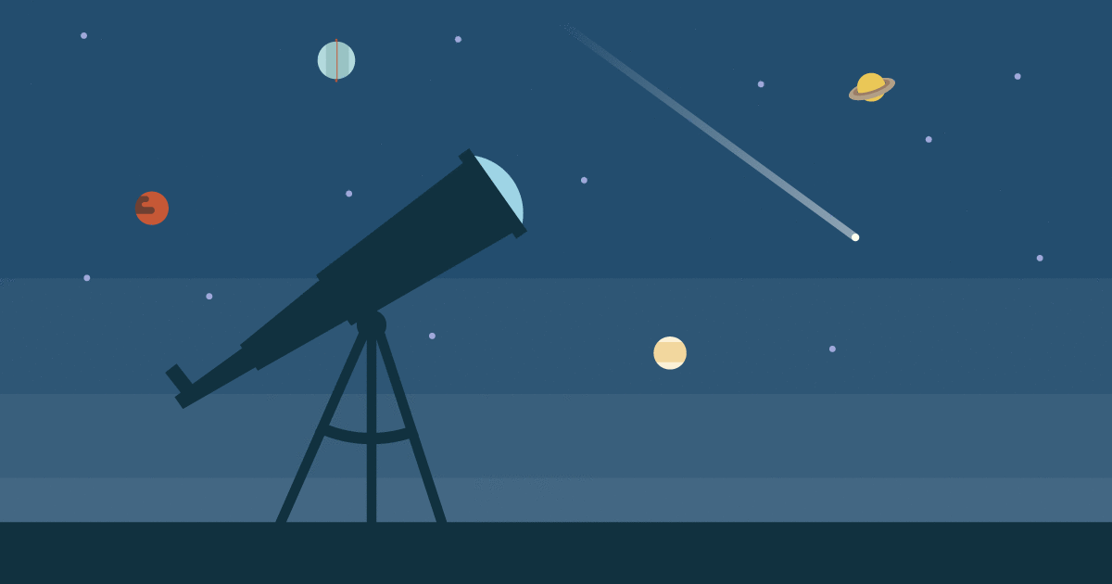
Telescopes 101

Slide 13
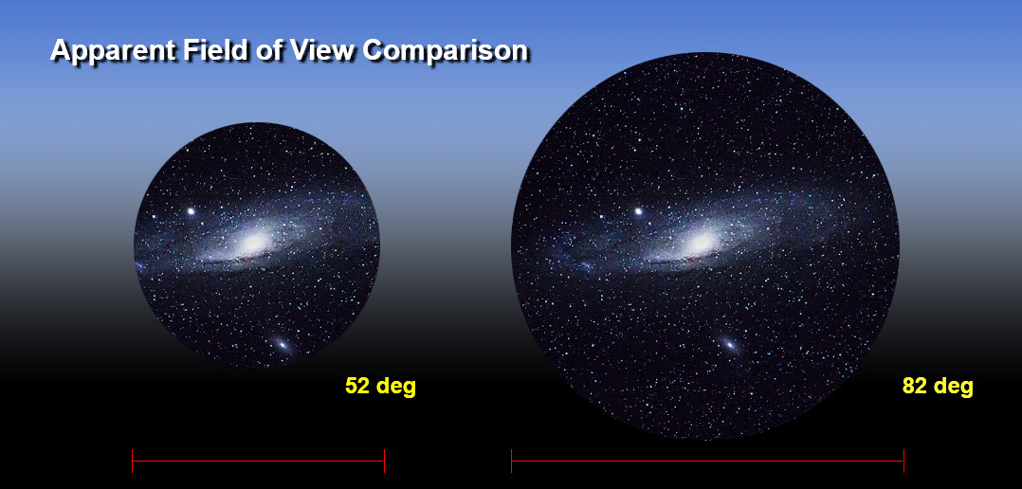
Field of View
The observable area that an observer can see

Slide 14
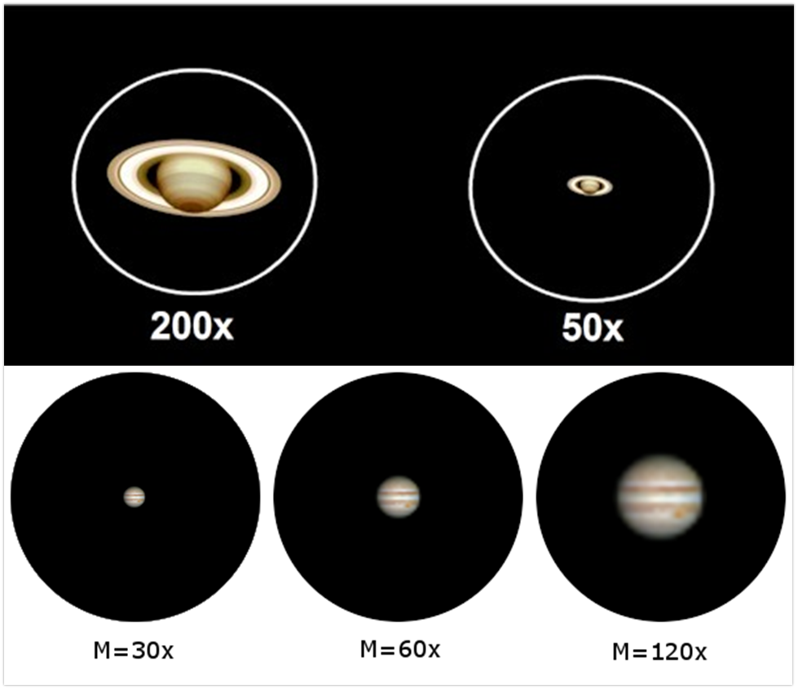
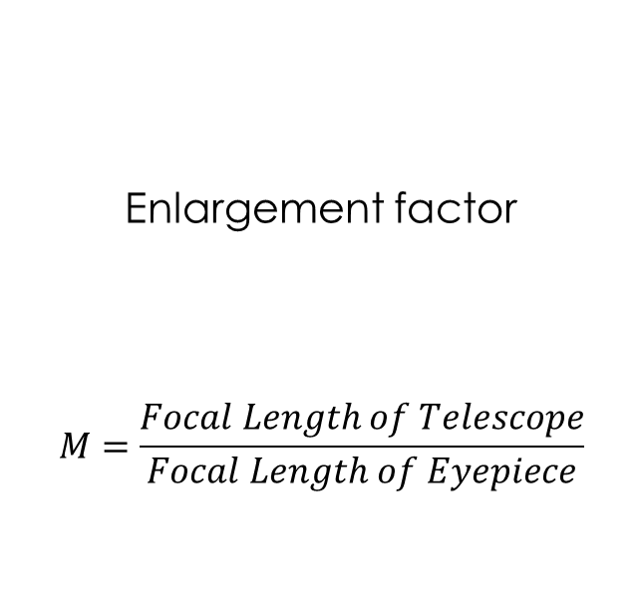
Magnification
Enlargement factor
$$M=\frac{Focal Length of Telescope}{Focal Length of Eyepiece}$$

Slide 15
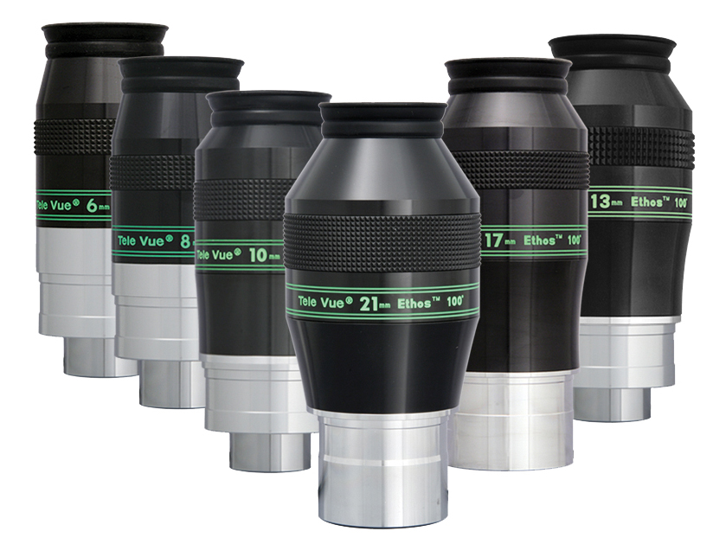
Magnification
Enlargement factor
$$M=\frac{Focal Length of Telescope}{Focal Length of Eyepiece}$$

Slide 16
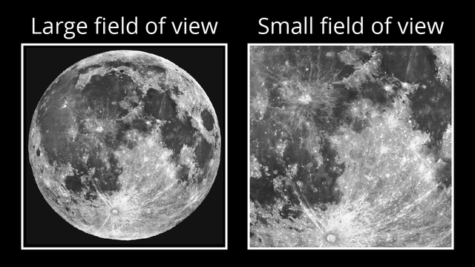
Field of View vs. Magnification
Having a larger
magnification
gives you a smaller
field of view

Slide 17
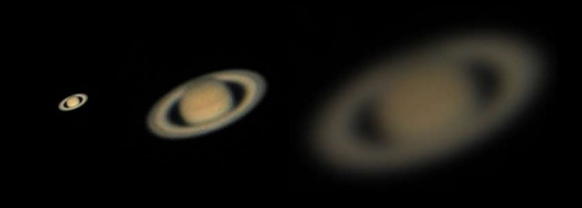
Larger magnification
light is spread out over a larger area
→ object appears dimmer

Slide 18
Solution?

Slide 19
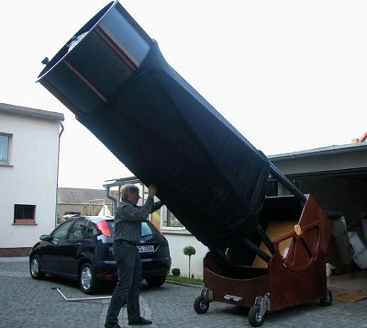
Use a bigger telescope!
Gather more light
over a larger area

